Slide 1

Cummins College Of Engineering For Women Nagpur Guided By: Prof.Avantika Wadaskar
Presented By
Amrapali Barsagade
Shejal Tingre
Sayali Dubey

Slide 2

Brain Tumor Detection Using Deep Learning

Slide 3
Contents
Introduction
Objective
Flowchart
Why choose Brain Tumor
Problem Statement
Problem Solution
Technologies Used

Slide 4
Introduction
Brain tumors are serious and potentially life-threatening conditions that require prompt diagnosis and treatment.
Accurately detecting brain tumors is challenging for medical professionals, and misdiagnosis can have severe consequences.
Recently, deep learning has emerged as a powerful tool for medical image analysis, with brain tumor detection being an area of significant promise

Slide 5
Objective
To develop a system for detecting brain tumors using medical imaging techniques such as MRI or CT Scans by using deep learning algorithms.
This project aims to use deep learning algorithms, such as convolutional neural networks (CNNs), to assist in detecting and diagnosing brain tumors from medical imaging data.
By leveraging deep learning, the project seeks to improve the accuracy and speed of brain tumor diagnosis, ultimately leading to better patient outcomes.

Slide 6
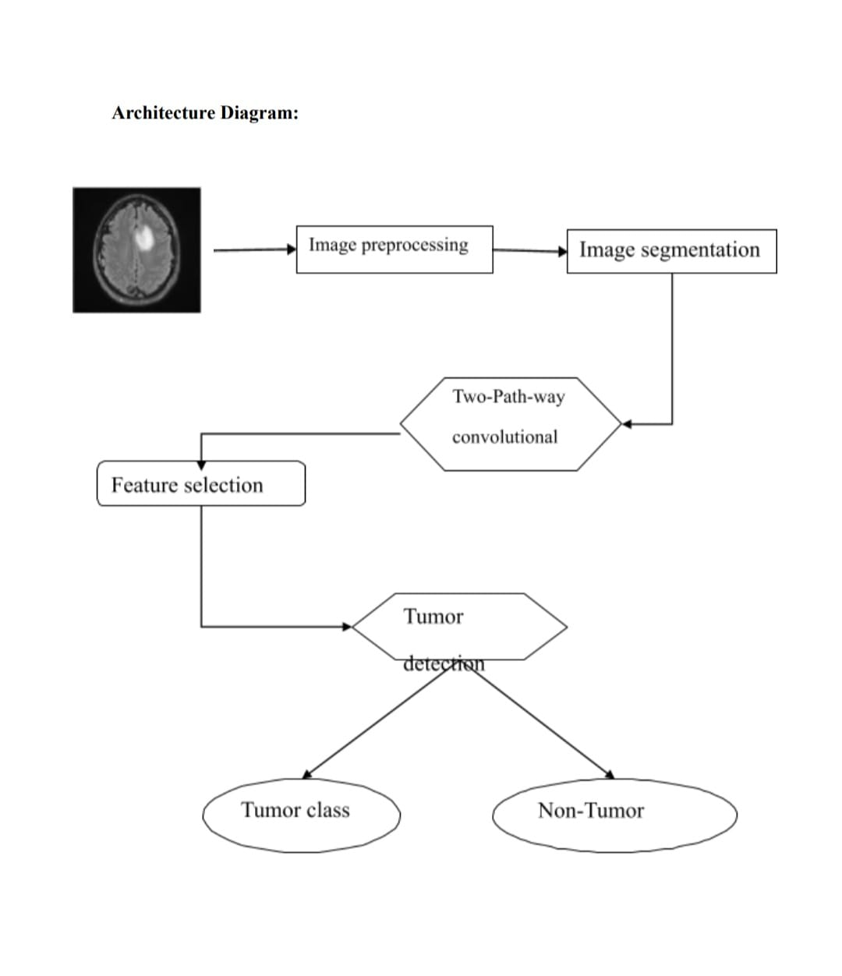
Flowchart

Slide 7
Problem Statement
- The project aims to develop a CNN (Convolutional Neural Network) model that can accurately predict the presence of brain tumors in medical images and classify the tumors into different types.
The goal is to assist medical professionals in diagnosing brain tumors accurately and efficiently, potentially leading to earlier detection, improved patient outcomes, and saving lives.
Brain tumors are a leading cause of cancer-related deaths worldwide, and accurate diagnosis is critical for effective treatment.
The success of the project relies on several factors, including the quality and size of the dataset, the choice of CNN architecture and hyperparameters, and the testing and validation of the model.

Slide 8
Problem Solutions
-Develop a convolutional neural network (CNN) model that can accurately predict the presence of brain tumors in medical images and classify the tumors into different types.-
Train the CNN model on a dataset of medical images of brains with and without tumors to learn to identify patterns in the images that correspond to the presence of tumors.
Optimize the CNN architecture and hyperparameters to improve the accuracy and efficiency of the model.
Test and validate the CNN model on new, unseen medical images to ensure it can accurately predict brain tumors in diverse scenarios

Slide 9
Tools And Technologies Used
Programming Languages
Python is preferred due to its extensive libraries for image processing.
Libraries
NumPy
Pandas for data manipulation
Model development
Platforms
JupYter Notebook
Any Deployment platform like AWS or google cloud for hosting the application

Slide 10

Thank you

